Slide 4
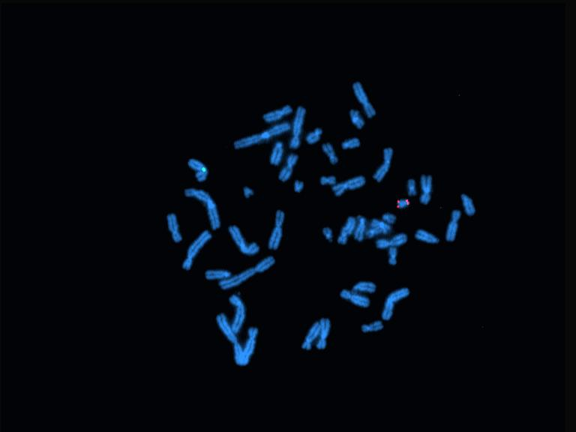

Slide 7
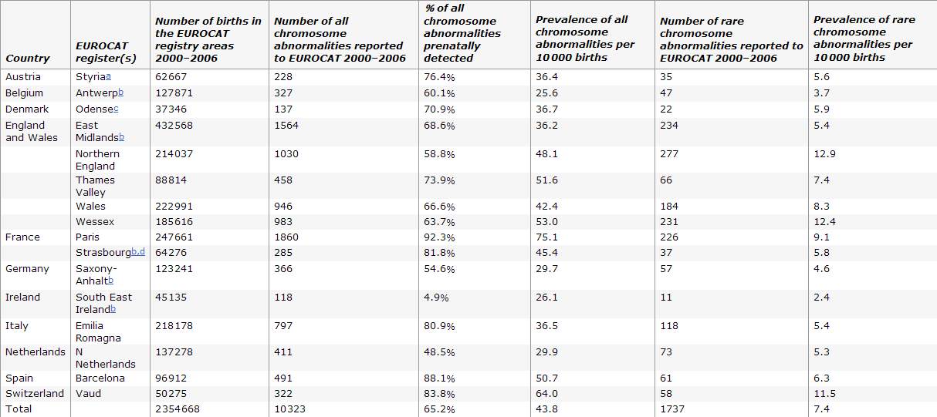
Rare chromosome abnormalities, prevalence and prenatal diagnosis rates from population-based congenital anomaly registers in Europe Diana Wellesley, Helen Dolk, Patricia A Boyd, RuthG reenlees, Martin Haeusler, Vera Nelen, Ester Garne, Babak Khoshnood, Berenice Doray, Anke Rissmann, Carmel Mullaney, Elisa Calzolari, Marian Bakker, Joaquin Salvador, Marie-Claude Addor, Elizabeth Draper, Judith Rankin and David Tucker

Slide 8
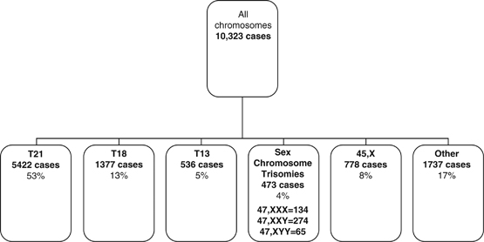
Rare chromosome abnormalities, prevalence and prenatal diagnosis rates from population-based congenital anomaly registers in Europe Diana Wellesley, Helen Dolk, Patricia A Boyd, Ruth Greenlees, Martin Haeusler, Vera Nelen, Ester Garne, Babak Khoshnood, Berenice Doray, Anke Rissmann, Carmel Mullaney, Elisa Calzolari, Marian Bakker, Joaquin Salvador, Marie-Claude Addor, Elizabeth Draper, Judith Rankin and David Tucker

Slide 9
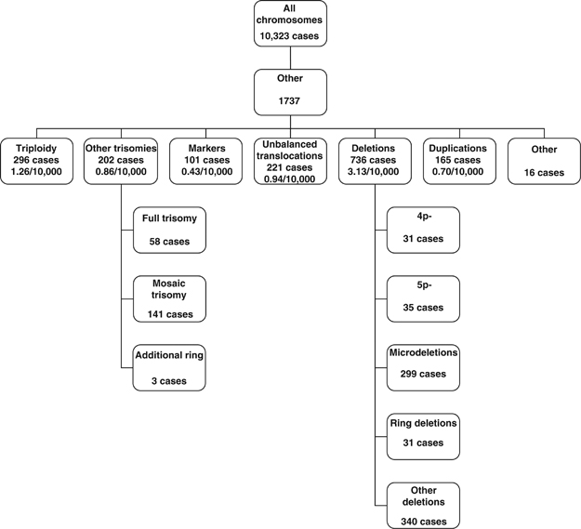
Rare chromosome abnormalities, prevalence and prenatal diagnosis rates from population-based congenital anomaly registers in Europe Diana Wellesley, Helen Dolk, Patricia A Boyd, Ruth Greenlees, Martin Haeusler, Vera Nelen, Ester Garne, Babak Khoshnood, Berenice Doray, Anke Rissmann, Carmel Mullaney, Elisa Calzolari, Marian Bakker, Joaquin Salvador, Marie-Claude Addor, Elizabeth Draper, Judith Rankin and David Tucker

Slide 10
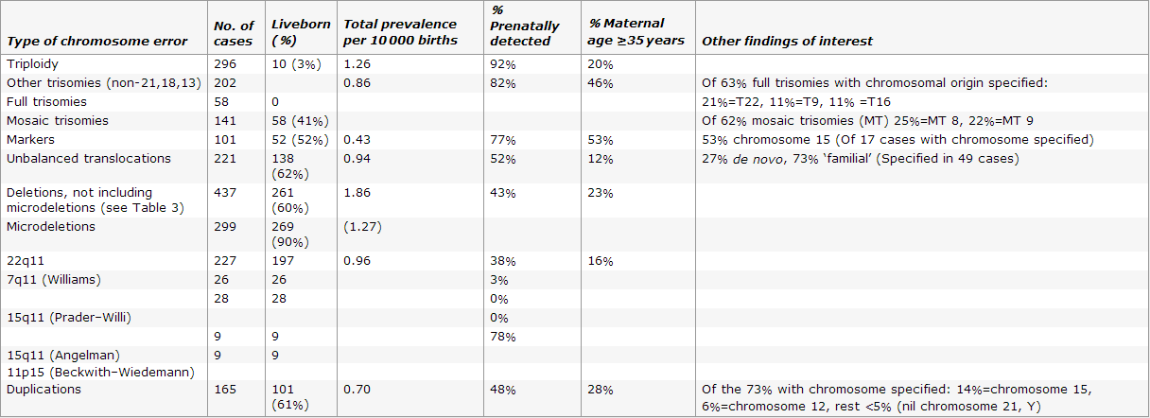
Rare chromosome abnormalities, prevalence and prenatal diagnosis rates from population-based congenital anomaly registers in Europe Diana Wellesley, Helen Dolk, Patricia A Boyd, Ruth Greenlees, Martin Haeusler, Vera Nelen, Ester Garne, Babak Khoshnood, Berenice Doray, Anke Rissmann, Carmel Mullaney, Elisa Calzolari, Marian Bakker, Joaquin Salvador, Marie-Claude Addor, Elizabeth Draper, Judith Rankin and David Tucker

Slide 12
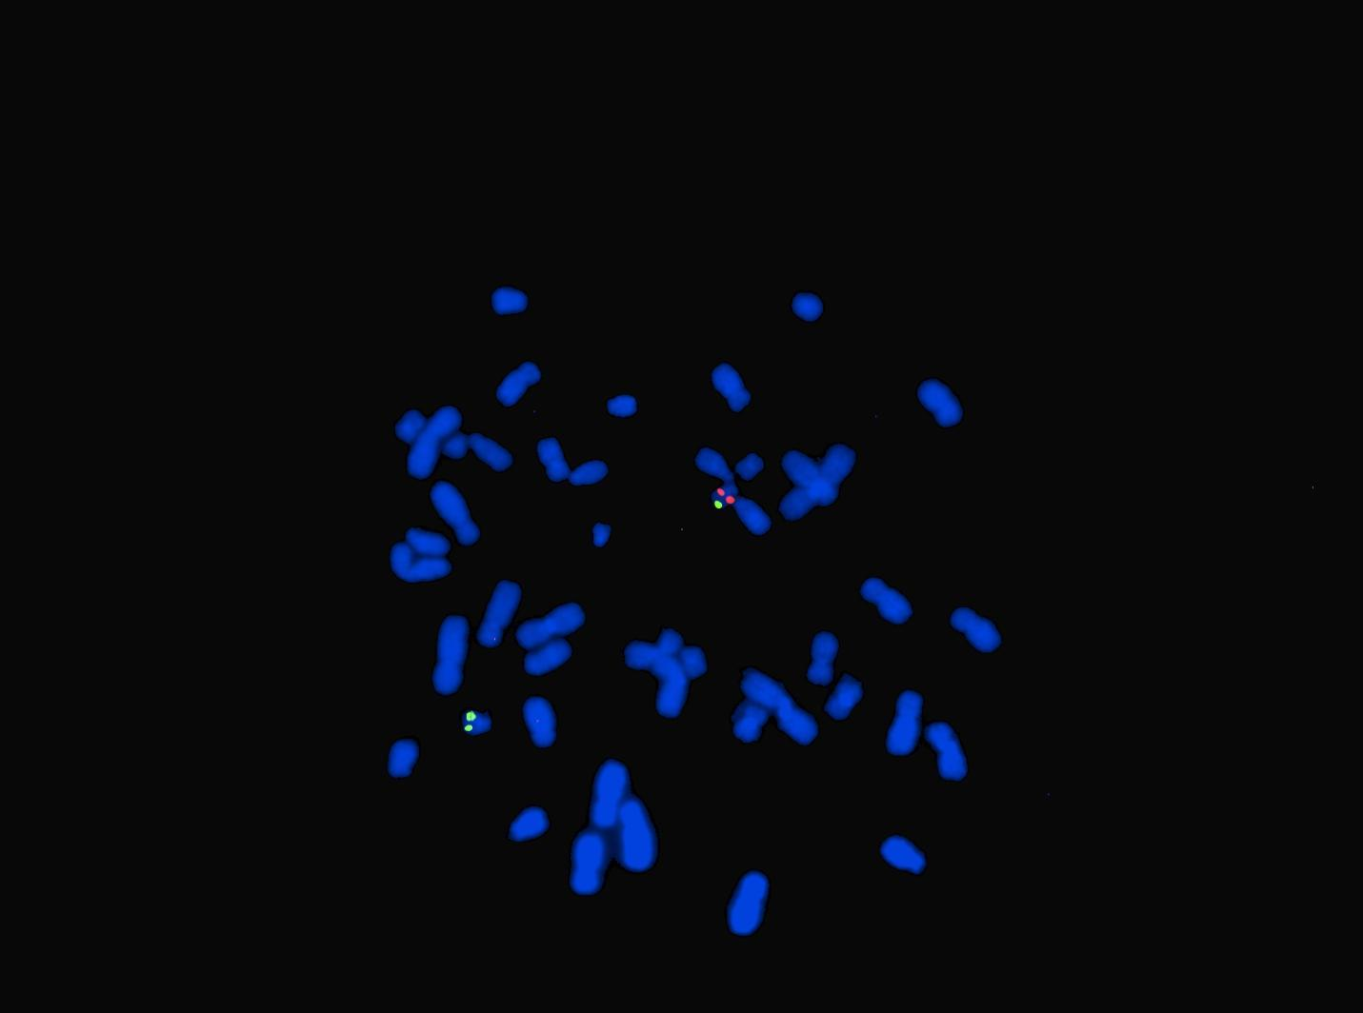

Slide 13
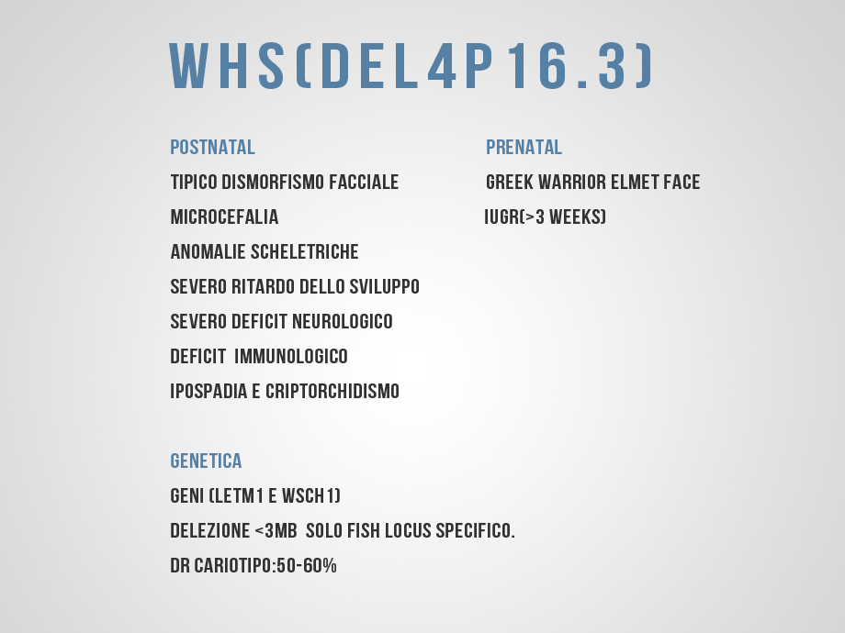

Slide 19
