Slide 1
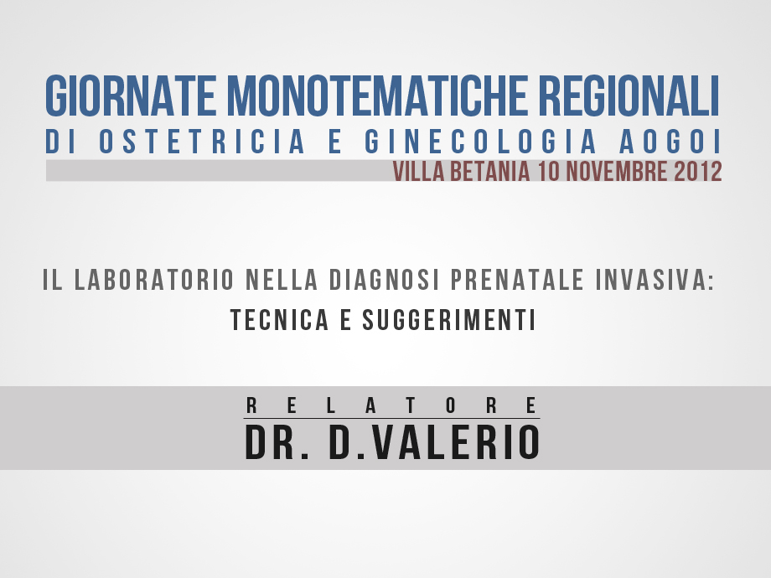

Slide 2
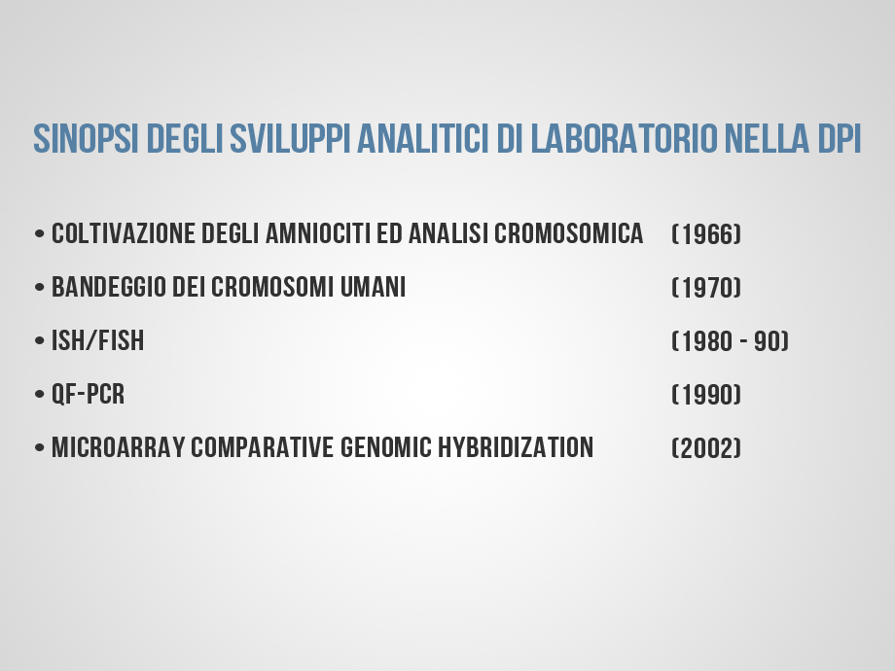

Slide 3
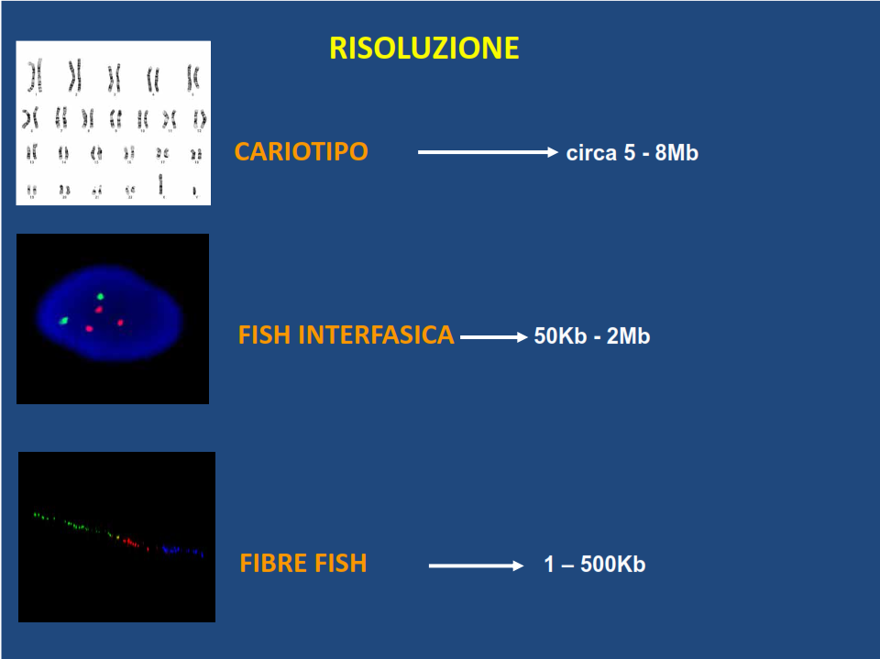

Slide 4
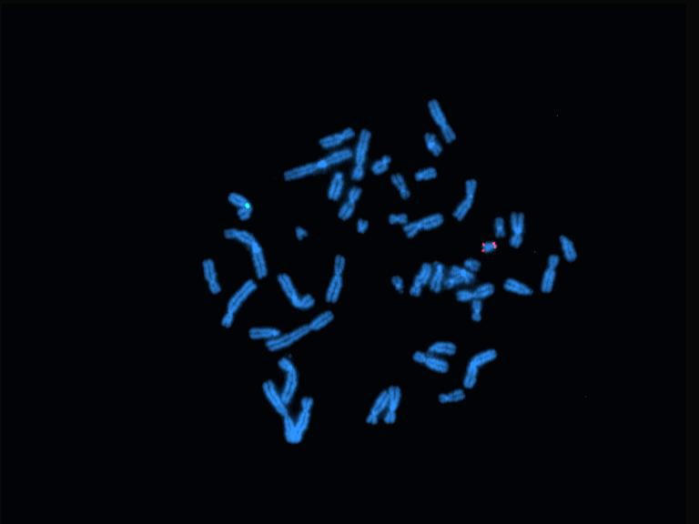

Slide 6
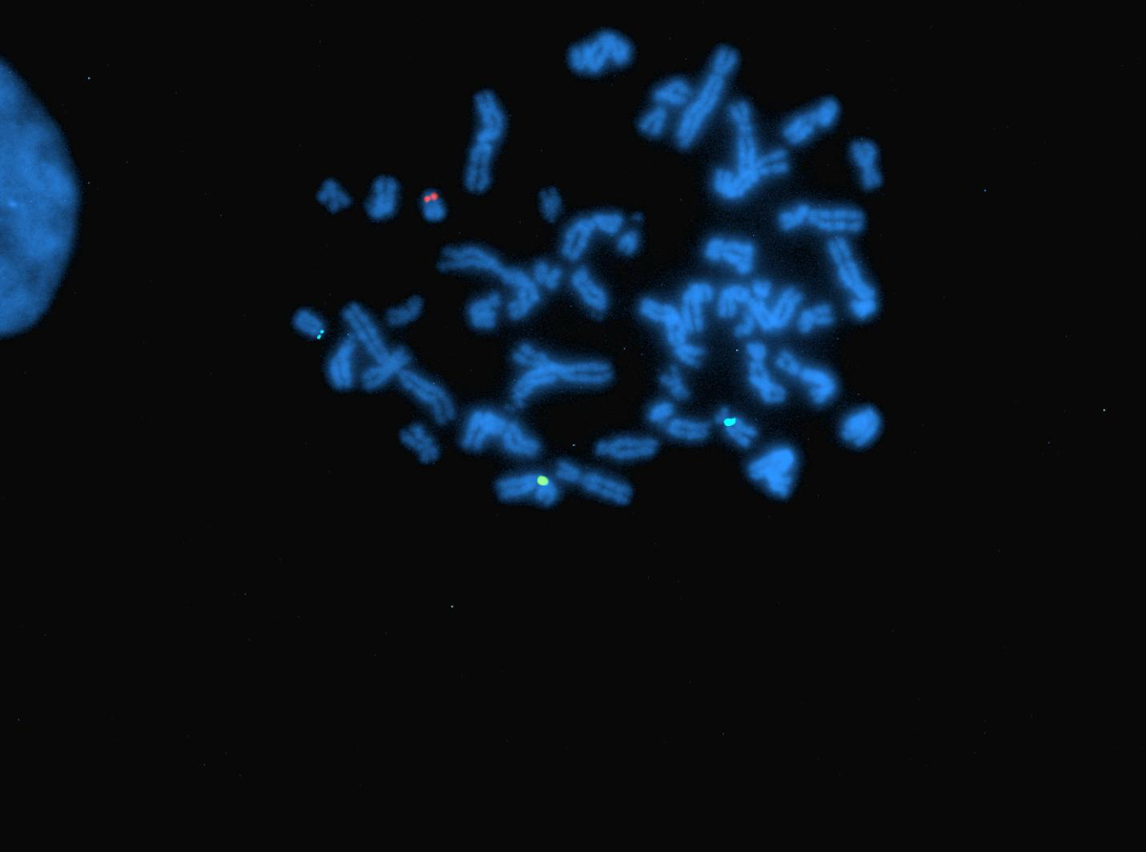

Slide 7
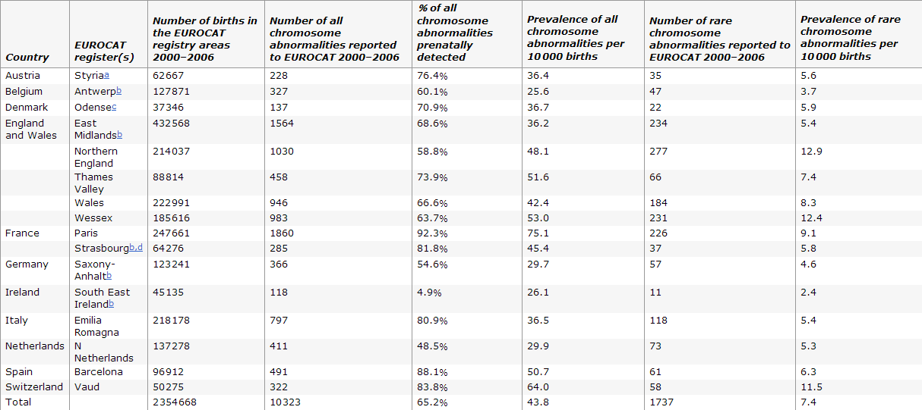
Rare chromosome abnormalities, prevalence and prenatal diagnosis rates from population-based congenital anomaly registers in Europe
Diana Wellesley, Helen Dolk, Patricia A Boyd, RuthG reenlees, Martin Haeusler, Vera Nelen, Ester Garne, Babak Khoshnood, Berenice Doray, Anke Rissmann, Carmel Mullaney, Elisa Calzolari, Marian Bakker, Joaquin Salvador, Marie-Claude Addor, Elizabeth Draper, Judith Rankin and David Tucker

Slide 8
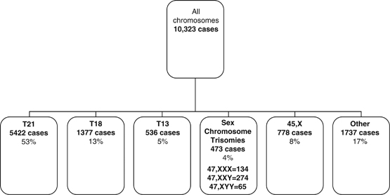
Rare chromosome abnormalities, prevalence and prenatal diagnosis rates from population-based congenital anomaly registers in Europe
Diana Wellesley, Helen Dolk, Patricia A Boyd, Ruth Greenlees, Martin Haeusler, Vera Nelen, Ester Garne, Babak Khoshnood, Berenice Doray, Anke Rissmann, Carmel Mullaney, Elisa Calzolari, Marian Bakker, Joaquin Salvador, Marie-Claude Addor, Elizabeth Draper, Judith Rankin and David Tucker

Slide 9
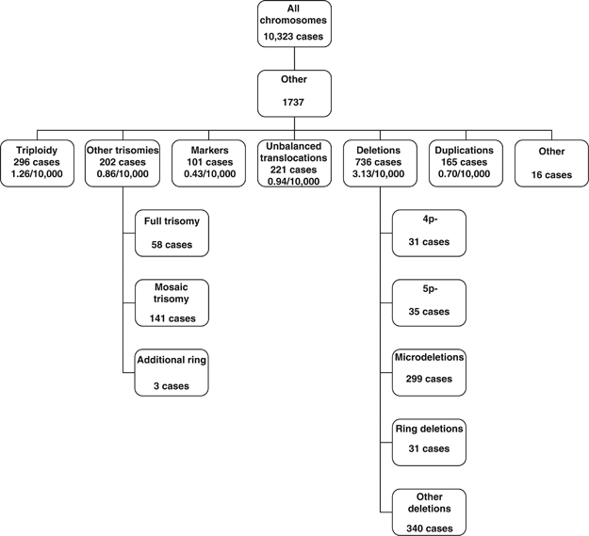
Rare chromosome abnormalities, prevalence and prenatal diagnosis rates from population-based congenital anomaly registers in Europe
Diana Wellesley, Helen Dolk, Patricia A Boyd, Ruth Greenlees, Martin Haeusler, Vera Nelen, Ester Garne, Babak Khoshnood, Berenice Doray, Anke Rissmann, Carmel Mullaney, Elisa Calzolari, Marian Bakker, Joaquin Salvador, Marie-Claude Addor, Elizabeth Draper, Judith Rankin and David Tucker

Slide 10
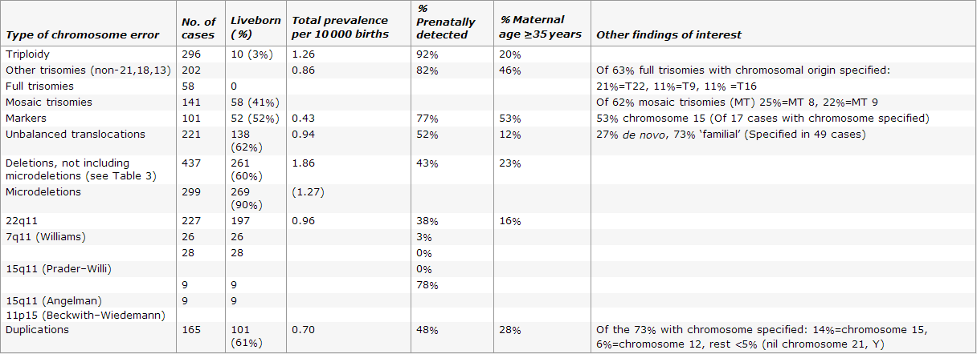
Rare chromosome abnormalities, prevalence and prenatal diagnosis rates from population-based congenital anomaly registers in Europe
Diana Wellesley, Helen Dolk, Patricia A Boyd, Ruth Greenlees, Martin Haeusler, Vera Nelen, Ester Garne, Babak Khoshnood, Berenice Doray, Anke Rissmann, Carmel Mullaney, Elisa Calzolari, Marian Bakker, Joaquin Salvador, Marie-Claude Addor, Elizabeth Draper, Judith Rankin and David Tucker

Slide 11
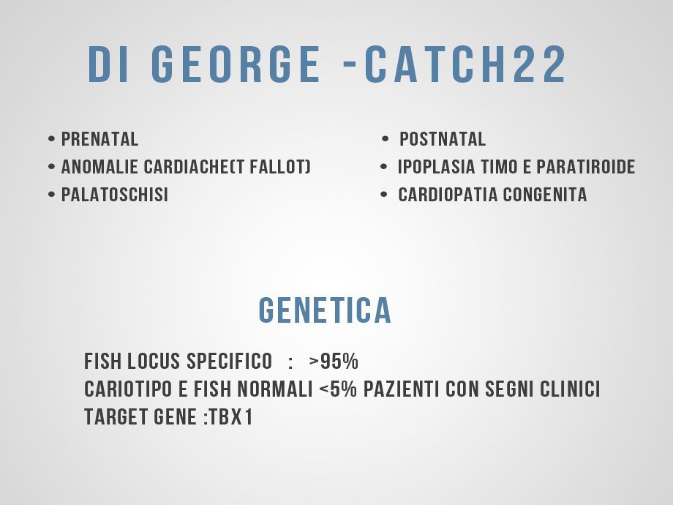

Slide 12
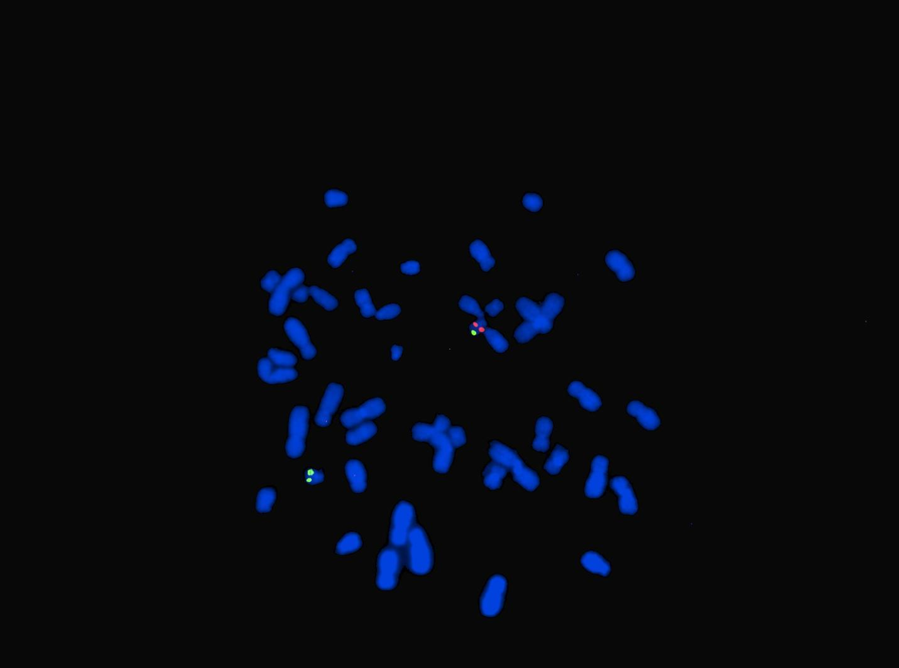

Slide 13
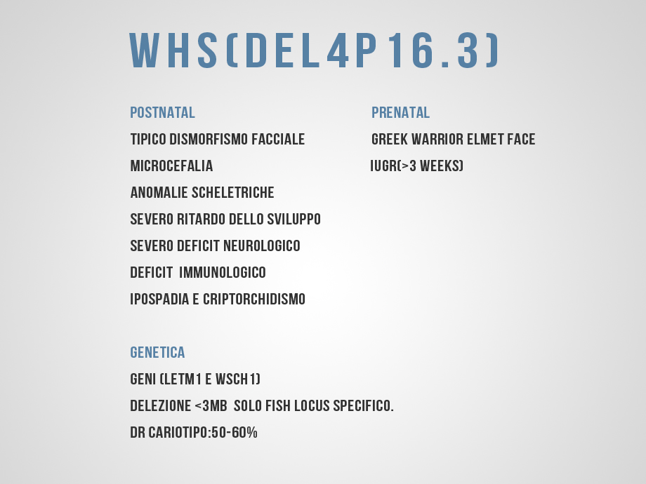

Slide 14
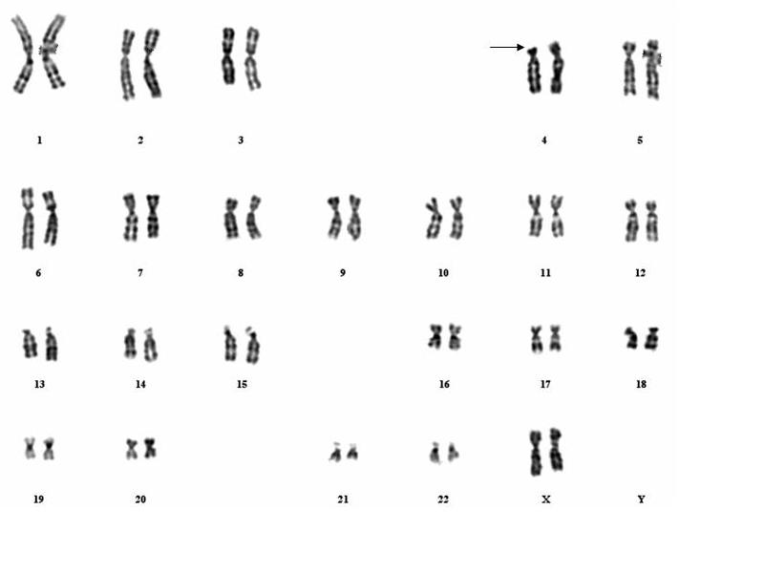

Slide 15
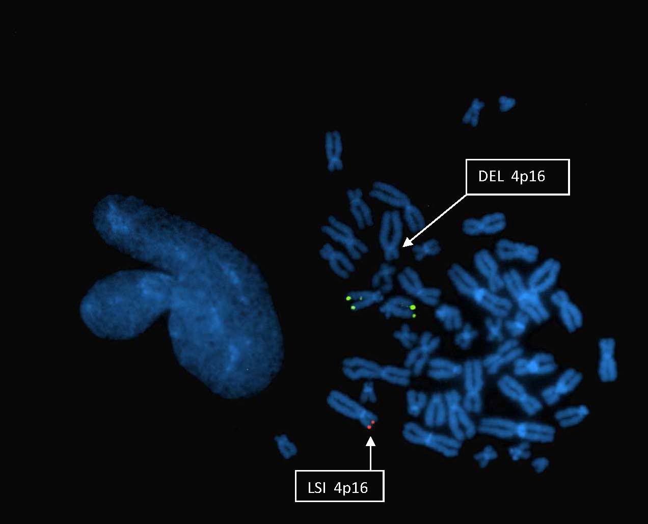

Slide 16
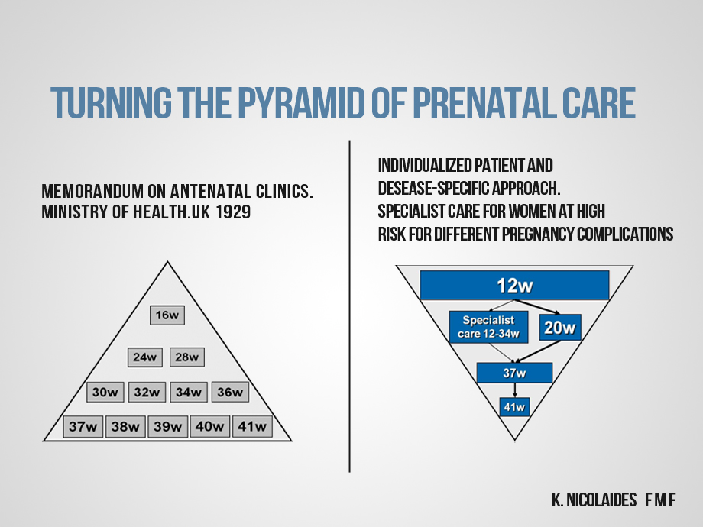

Slide 19
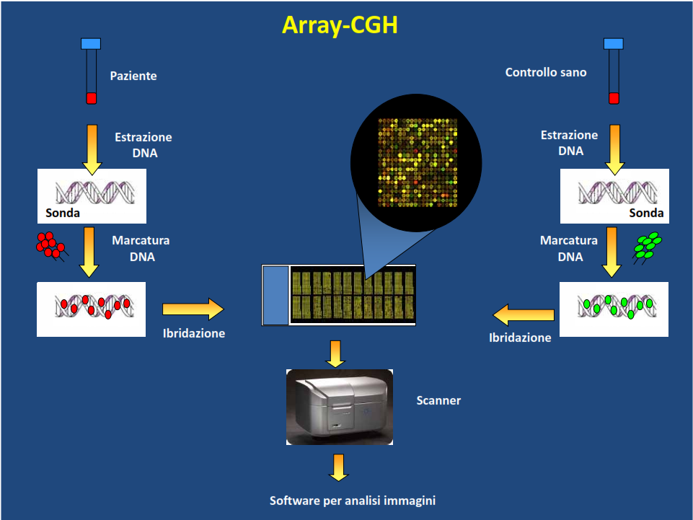

Slide 20
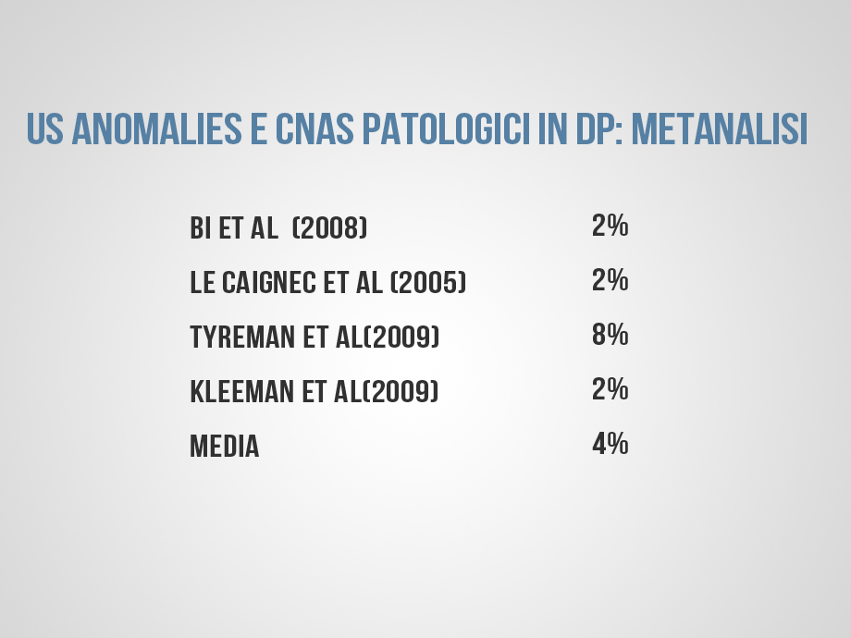

Slide 21
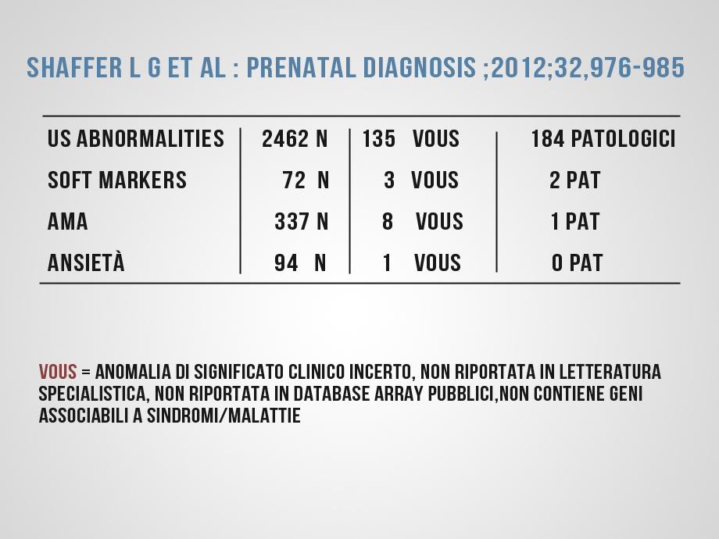

Slide 22
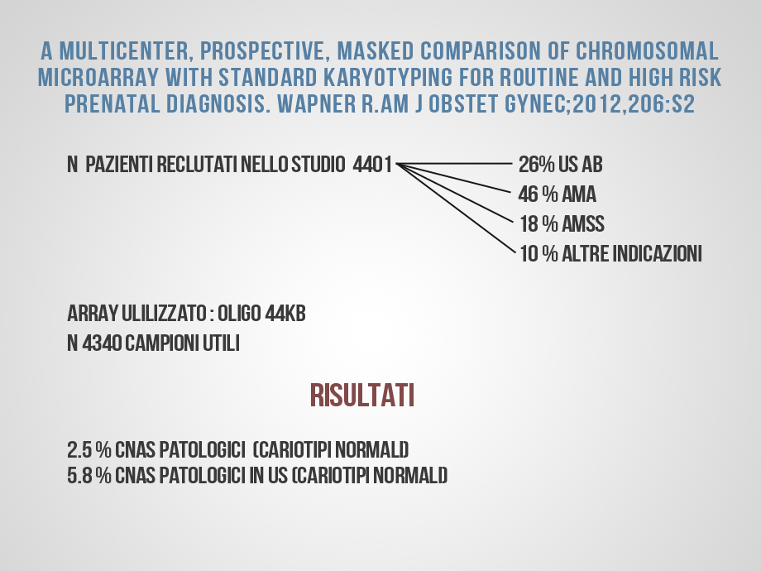

Slide 23
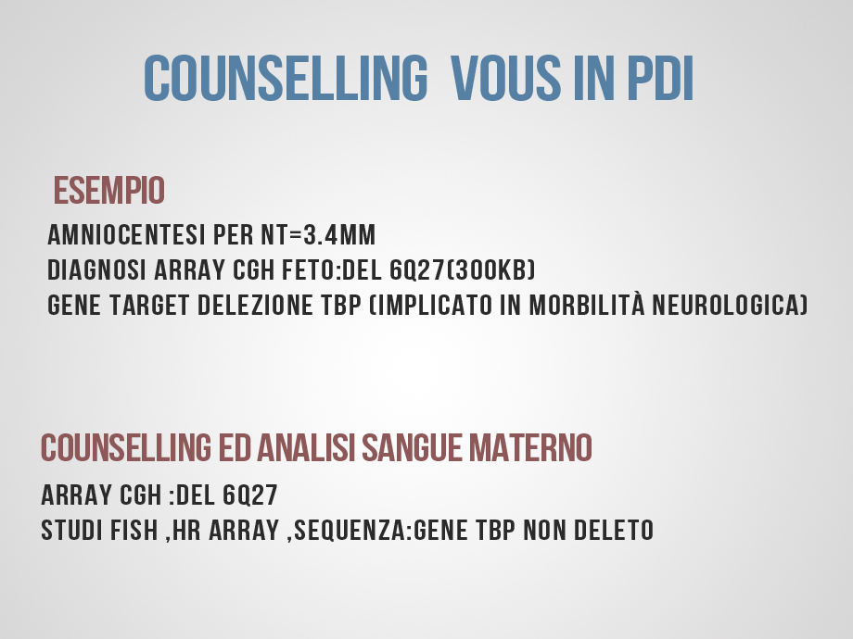

Slide 24
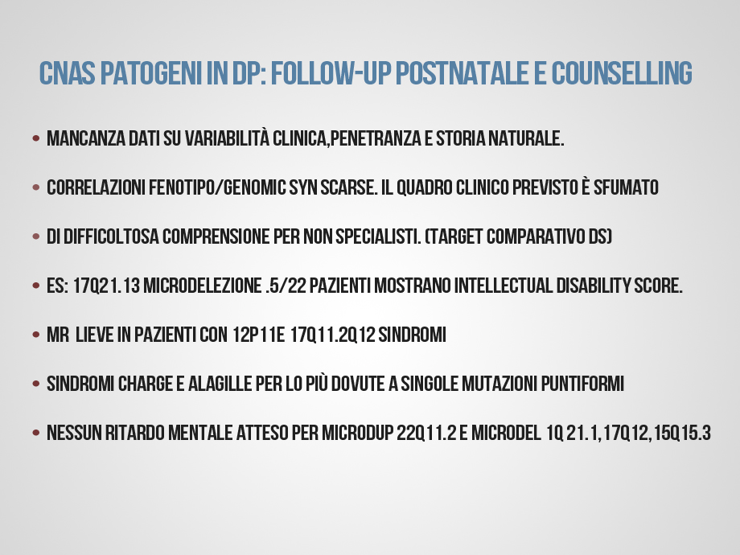

Slide 25
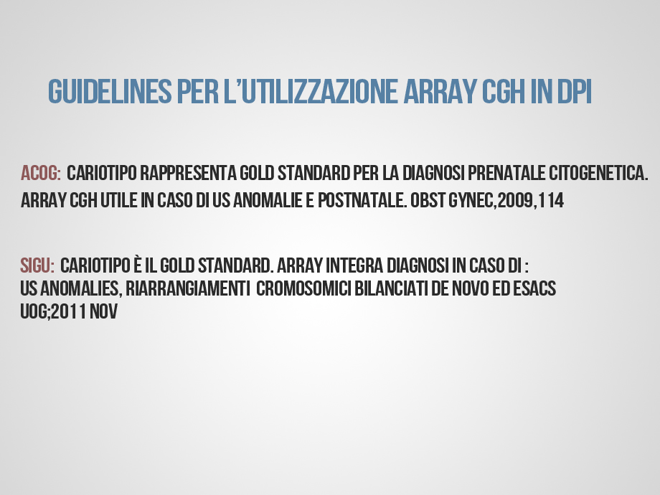

Slide 26


